Slide 1

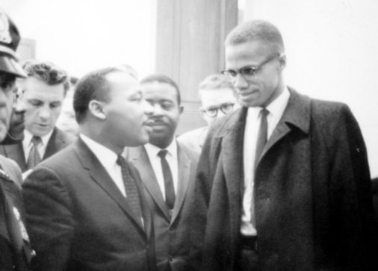
Quick Right or Wrong
Which approach to social justice is more effective?
MLK: Peacefully protest to be
recognized as part of the mainstream
Malcolm X: Fight for rights and maintain independence from the dominant culture
North Senior Academy

Slide 2

Urban Literacy
Literature, Language
and Communication Arts
North Senior Academy
North of Excellence!

Slide 3


Learning Target
I can actively view and listen to comprehend a complex text.
North Senior Academy

Slide 4
Our Agenda
Quick-Share
Vocabulary:
Narrative Elements
African American Authors
Hansberry – themes
A Raisin in the Sun
North Senior Academy

Slide 5
Quick Right - Share
Which approach to social justice is more effective?
MLK: Peacefully protest to be
recognized and join with the mainstream
Malcolm X: Fight for rights and maintain independence from the dominant culture
North Senior Academy

Slide 6

North Senior Academy

Slide 7
Thursday
Literary Techniques
Vocabulary Make-Up Test
North Senior Academy

Slide 8

Narrative Elements
Parts of a story
a narrative is
any story – fiction or nonfiction
North Senior Academy

Slide 9
Narrative Elements
Parts of a story
Character – Plot – Setting – Conflict Theme
Who? What? When/Where? Why? How?
North Senior Academy

Slide 10
Narrative Elements
Mood
the atmosphere and feeling of a text
Tone
author's attitude toward the subject or characters
How?
North Senior Academy

Slide 11
Narrative Elements
Character
Plot
Setting
Conflict
Theme
Mood
Tone
North Senior Academy

Slide 12
African American Author
BLOG RUBRIC
Completion - all assignment requirements met
Creativity - writing shows some depth of thought or conveys original ideas
Clarity - most writing is clear, using standard conventions
Construction - well-organized and structured text
North Senior Academy

Slide 13
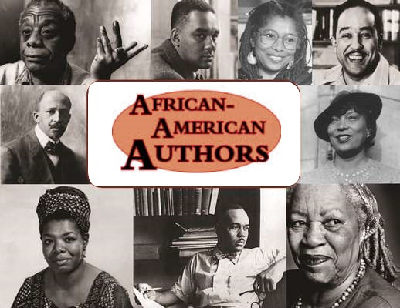
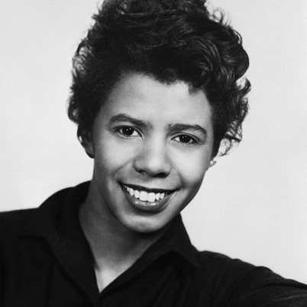
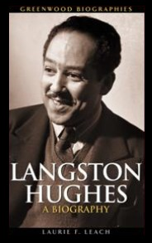
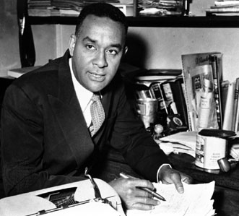
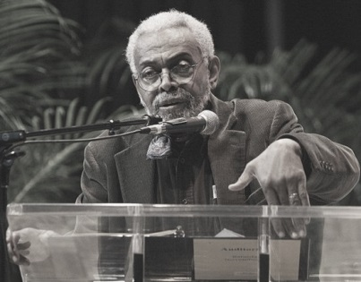
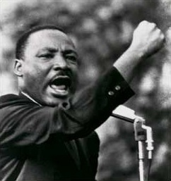
Take Notes on Basic Info
North Senior Academy

Slide 14
Lorraine Hansberry
Born in Chicago, IL on May 19, 1930
Playwright and civil rights activist
First Black woman to have a play produced on Broadway
Died on January 12, 1965

Slide 15
A Raisin in the Sun
Opened on Broadway on March 11, 1959
Made into a film starring most of the Broadway cast in 1961
TV Movie with Sean Combs and Phylicia Rashad – 2008
Denzel Washington and Diahann Carroll
set to star in Broadway revival
– March, 2014

Slide 16

Hansberry’s title may
also metaphorically imply
an upbringing (a raising)
in a sunny place that
encourages growth

Slide 17
Themes
Value systems within families
Concepts of African American beauty
vs. European beauty
Class and generational conflicts
Male pride
Rising feminism
Assimilation –
“melting pot” vs. multiculturalism

Slide 18
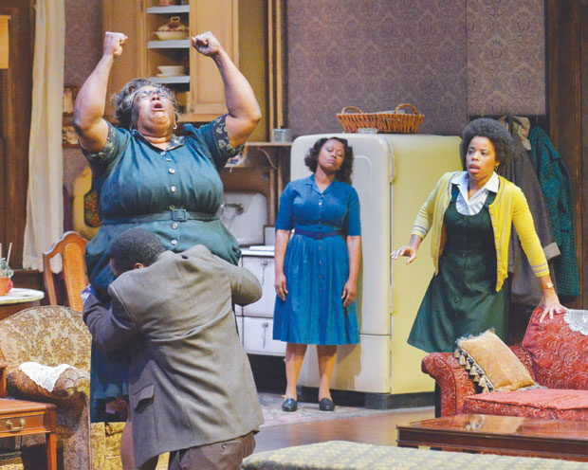

Slide 19
North Senior Academy

Slide 20
Active Listening / Viewing
Listening/Viewing
Proficiency
Rubric
North Senior Academy

Slide 21
Active Listening / Viewing
Student always takes a voluntary, thoughtful and active role in his/her learning through listening -- challenging him/herself to pay attention to even unfamiliar text; always focused exclusively on the material presented. Critically evaluates text for point of view, reasoning and intended audience.
Rubric
North Senior Academy

Slide 22
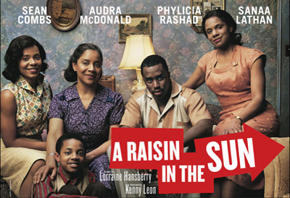
A Raisin in the Sun
North Senior Academy

Slide 23
North Senior Academy

Slide 24
Setting
South Side, Chicago
some time between World War II and the present

Slide 25
Main Characters
Ruth Younger
Travis Younger
Walter Lee Younger (brother)
Beneatha Younger (sister)
Lena Younger (Mama)
George Murchison
Joseph Asagai
Karl Lindner

