Slide 1

Dramatic Structure
Critical Response
A Raisin in the Sun
North Senior Academy

Slide 2
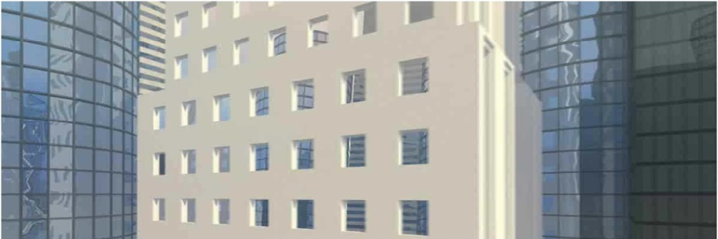
Urban Literacy
Literature, Language
and Communication Arts
North Senior Academy
North of Excellence

Slide 3


Learning Target
I can analyze
a text for
dramatic structure.
North Senior Academy

Slide 4
Our Agenda
Dramatic Structure
“Little Red Riding Hood”
A Raisin in the Sun Discussion
Critical Response questions
North Senior Academy

Slide 5
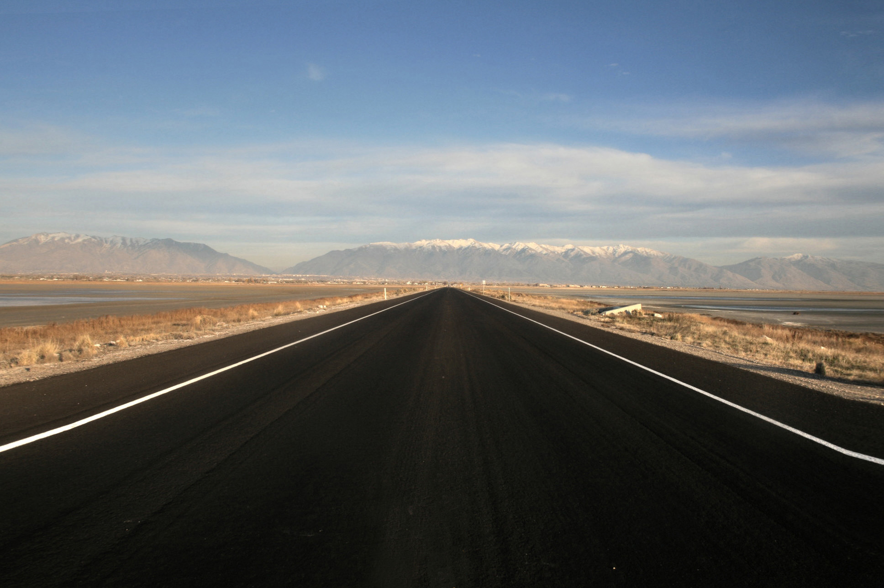
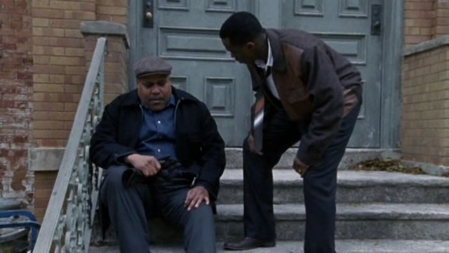
Dramatic Structure
A Raisin in the Sun

Slide 7
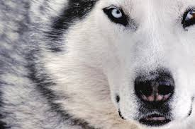
Little Red Riding Hood A Raisin in the Sun
Protagonist:
main character in a story (“hero”)
Antagonist:
opponent or force in conflict with the hero (“villain”)
Comedy: Protagonist wins conflict;
has a happy ending
Tragedy: Antagonist overtakes hero;
ends in sadness, loss or death
Notes:
This method is also referred to as Subject by Subject or Whole to Whole. With this pattern (AB,AAA,BBB,AB A = Person or Place, Thing, Idea #1 and B = Person or Place, Thing, Idea # 2 ) you first discuss all of the details for one subject, in this case the BMW, and then all of the details for the second subject, the Honda Civic. The conclusion will reach some sort of final evaluation about the items you have chosen for your paper. If you were writing about cars, you might conclude your paper by making a selection based on the criteria. For example: Based on the excellent mileage, the low cost of insurance, and the price of the vehicle, the Honda Civic will definitely be my choice when I buy a new car.

Slide 8

Little Red Riding Hood A Raisin in the Sun
Is “Little Red Riding Hood”
a comedy or a tragedy?
Comedy: Protagonist wins conflict;
has a happy ending
Tragedy: Antagonist overtakes hero;
ends in sadness, loss or death
Notes:
This method is also referred to as Subject by Subject or Whole to Whole. With this pattern (AB,AAA,BBB,AB A = Person or Place, Thing, Idea #1 and B = Person or Place, Thing, Idea # 2 ) you first discuss all of the details for one subject, in this case the BMW, and then all of the details for the second subject, the Honda Civic. The conclusion will reach some sort of final evaluation about the items you have chosen for your paper. If you were writing about cars, you might conclude your paper by making a selection based on the criteria. For example: Based on the excellent mileage, the low cost of insurance, and the price of the vehicle, the Honda Civic will definitely be my choice when I buy a new car.

Slide 9
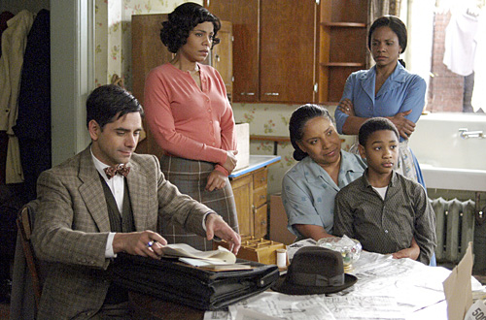
Little Red Riding Hood A Raisin in the Sun
Three Part Structure
The Protagonist is given a task and a warning
Protagonist goes off the beaten path
Protagonist confronts the Antagonist
3
Notes:
This method is also referred to as Subject by Subject or Whole to Whole. With this pattern (AB,AAA,BBB,AB A = Person or Place, Thing, Idea #1 and B = Person or Place, Thing, Idea # 2 ) you first discuss all of the details for one subject, in this case the BMW, and then all of the details for the second subject, the Honda Civic. The conclusion will reach some sort of final evaluation about the items you have chosen for your paper. If you were writing about cars, you might conclude your paper by making a selection based on the criteria. For example: Based on the excellent mileage, the low cost of insurance, and the price of the vehicle, the Honda Civic will definitely be my choice when I buy a new car.

Slide 10
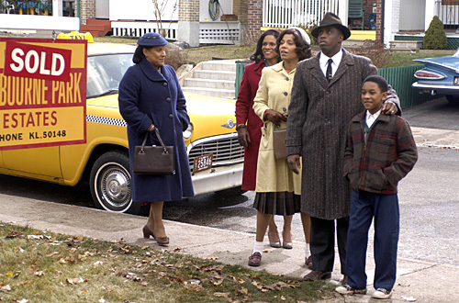
A Raisin in the Sun
Structure Analysis
Discussion
Speak one at a time
Use appropriate language
Actively Listen to others

Slide 11
Critical Response
A Raisin in the Sun
North Senior Academy

Slide 12
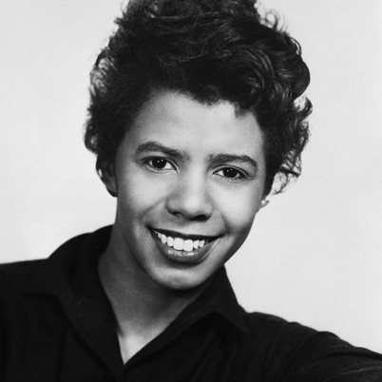
Little Red Riding Hood A Raisin in the Sun
Lorraine Hansberry
Born in Chicago - 1930
First Black woman to have a play produced on Broadway
Play opened on Broadway - 1959
Notes:
This method is also referred to as Subject by Subject or Whole to Whole. With this pattern (AB,AAA,BBB,AB A = Person or Place, Thing, Idea #1 and B = Person or Place, Thing, Idea # 2 ) you first discuss all of the details for one subject, in this case the BMW, and then all of the details for the second subject, the Honda Civic. The conclusion will reach some sort of final evaluation about the items you have chosen for your paper. If you were writing about cars, you might conclude your paper by making a selection based on the criteria. For example: Based on the excellent mileage, the low cost of insurance, and the price of the vehicle, the Honda Civic will definitely be my choice when I buy a new car.

Slide 15
A Raisin in the Sun
Literary Techniques
Symbolism
(Metaphor)
Motif
Irony
Allusion
Foreshadowing

Slide 16

A Raisin in the Sun – Main Characters
Lena Younger (Mama)
Walter Lee Younger (brother)
Beneatha Younger (sister)
Ruth Younger (Walter’s wife)
Travis Younger (Walter’s son)
George Murchison
Joseph Asagai
Karl Lindner
North Senior Academy

