Slide 1
Urban Literacy Dream Workshop
Ideas for the Ideal
Urban Language Arts Classroom Design
Vance Holmes

Slide 2
Urban Literacy Dream Workshop
The physical environment of the urban literacy classroom is so critical to building an energized learning community, its importance cannot be overstated.

Slide 3
Urban Literacy Dream Workshop
Room Color and Mood
Furniture Arrangement
Instructive Design Choices

Slide 4
Urban Literacy Dream Workshop
Room Color and Mood
Blue is said to bring down blood pressure and slow respiration and heart rate. That is why it is considered calming, relaxing and serene. Blue – especially a warmer blue, such as periwinkle – is known to have a calming effect when used as the main color of a room.
Purple in its darkest values is rich, dramatic, and sophisticated. It is associated with luxury as well as creativity, and as an accent or secondary color, it gives a scheme depth.

Slide 5
Urban Literacy Dream Workshop
Room Color and Mood
Orange evokes excitement, enthusiasm and is an energetic color. In ancient cultures orange was believed to heal the lungs and increase energy levels.
Red raises a room’s energy level. In the right shade, it can be a good choice if you want to stir up excitement and stimulate conversation.

Slide 6
Urban Literacy Dream Workshop
Room Color and Mood
Green is considered the most restful color for the eye, combining the refreshing quality of blue and the cheerfulness of yellow. Green also has a calming effect when used as a main color for decorating.
Crimson can make some people feel irritable – invoking feels of rage and hostility.
Yellow, though cheery, is not a good main color choice. While chromo therapy findings suggest that yellow stimulates the nerves and purifies the body, in large amounts, this color tends to create feelings of frustration and anger in people.

Slide 7
Urban Literacy Dream Workshop
Furniture Arrangement
All chairs, desk and tables must be outfitted for quick and quiet movement.
Alternate types of seating should be available.
There should be a comfortable area for guests.
Ideally, the basic arrangement of furniture would have rows of tables (or desks) facing in to the center of the room.

Slide 8
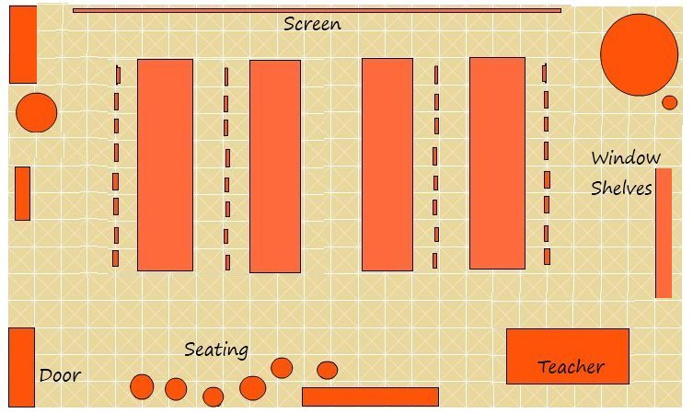
Urban Literacy Dream Workshop
Furniture Arrangement

Slide 9
Urban Literacy Dream Workshop
Instructive Design Choices
The classroom should have a generous amount of healthy plants.
The classroom must be well-lit with diverse light sources. Make full use of natural light. Use hanging plants and potted flowers near the windows to mask a bad view. Lamps will bring in special color and focus attention.
Mirrors reflect both natural and artificial light to make a room brighter during the day and night. Use a focal point and angle your mirrors towards it, which will give the illusion of depth. Mirrors on cabinet doors and reflective tabletops provide an open flow and make spaces feel large and uncluttered.

Slide 10
Urban Literacy Dream Workshop
Instructive Design Choices
The use of tables with separate chairs is far preferable to desk/chair units.
The ideal workshop has clean, empty, neutral vertical space.
The space must be clutter-free and open.
Table cover and chair pads should be considered.

Slide 11
Urban Literacy Dream Workshop
Instructive Design Choices
It is a generally accepted notion that light colors make a room look bigger and brighter. Light and brightly colored walls are more reflective making a space feel open and airy.
Use multi-function furniture.
Place large pieces of furniture against the walls. Consider having at least some of the furniture pieces the same color as the walls.

Slide 12
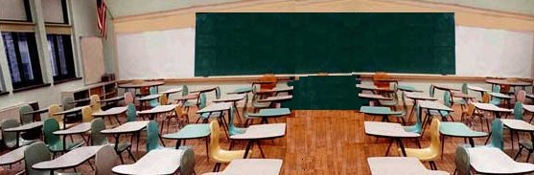
Urban Literacy Dream Workshop

Slide 13
Urban Literacy Dream Workshop
Ideas for the Ideal
Urban Language Arts Classroom Design

