Slide 1


William Shakespeare’s
North Senior Academy – Urban Literacy

Slide 2
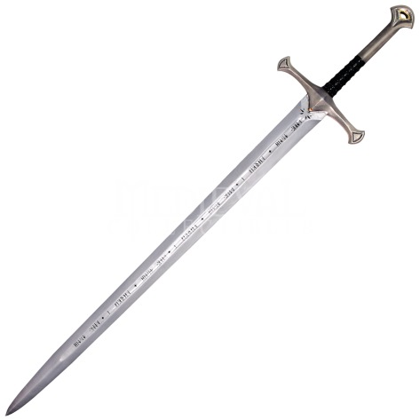
Overview

Slide 3
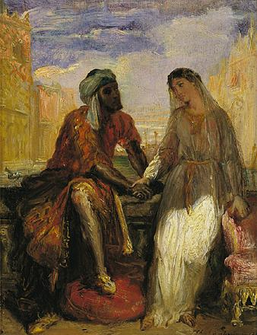
The Tragedy of Othello
As with most of Shakespeare's plays, Othello is an
adaptation of other works.
The plot of Othello is largely taken from Italian author Giraldi Cinthio's, Un Capitano Moro (1565) – a tale of love, jealousy and betrayal.
It has also been noted that Othello and
Un Capitano Moro resemble the earlier
tale of, “The Three Apples”
– a story from “One Thousand and One
Nights.” (Arabian Nights)

Slide 4
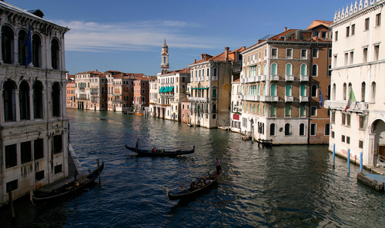
The Moor of Venice
The Tragedy of Othello

Slide 5
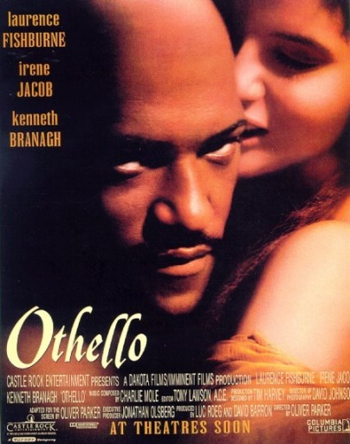
The Tragedy of Othello
First performed in 1603

Slide 6
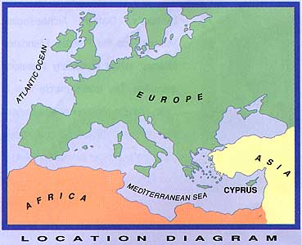
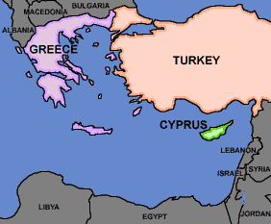
The Tragedy of Othello
Setting:
Begins in Venice, Italy
and transitions to the island of Cyprus.

Slide 7
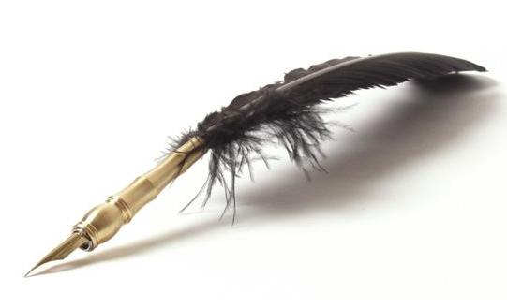
The Story

Slide 8
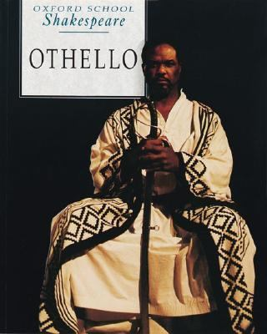
Othello - the Moor of Venice
Othello is a famous and highly respected military leader
– a top General – in Venice.
However, he is an outsider because he is from
another country and of another culture.
Othello is a Moor from North Africa.

Slide 9
Othello - the Moor of Venice
In Shakespeare’s day, Moor was equivalent to “African,"
but Othello’s precise intended ethnicity and cultural background is not clear.
Originally, the word Moor meant “native of Mauritania” –
a country in Africa.
Moor is also a name applied to certain
Arab peoples of North Africa –
who are Muslim.

Slide 10
Othello - the Moor of Venice
While certainly an outsider, Othello is a Christian – not a Muslim – and shows this throughout the play.
In 17th century England, Moors were commonly referred to as “devils” or “villains” and were said to be wicked. They were also thought to be sexually overactive and prone to jealousy and greed.
Moors were not associated with
slavery, since the slave trade would
not be established until the late
17th century.

Slide 11
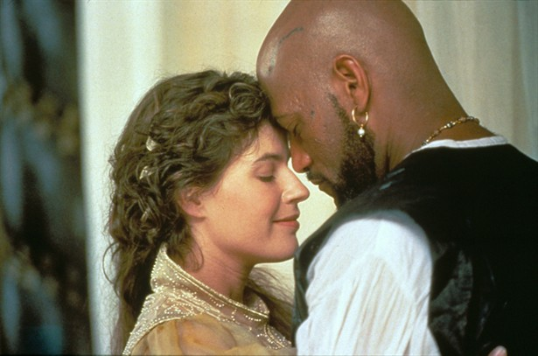
Othello - the Moor of Venice
Othello secretly marries the young, beautiful and noble, Desdemona.
Her father, Brabantio, wants Othello to be arrested.
Desdemona loves Othello and defies her father.

Slide 12

Othello - the Moor of Venice
The men in the military under Othello can’t all be trusted.
Cassio means well but is open to bad influences.
Iago pretends to be loyal, but secretly resents Othello for passing him over for promotion.

Slide 13
Othello - the Moor of Venice
Iago is determined to get revenge.
He decides to attack Othello in his most vulnerable spot . . .
his love for Desdemona.

Slide 14
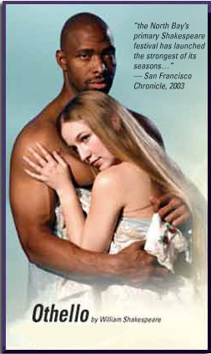
Will Othello be able to see through Iago’s schemes?
Or will jealousy and revenge lead to murder?

Slide 15

Themes

Slide 16
Shakespeare’s Othello
Racial prejudice is an important concept in Othello –
as is the idea of judging others on the basis of their appearance rather than what’s in their hearts.
Main Themes
Jealousy
Honesty
Reputation
Honor
Self-Knowledge
Pride (Self-Esteem)

Slide 17
Shakespeare’s Othello
Motifs
Magic
Waters / Storms
Proof / Judgment
The Handkerchief
The Devil
Black and White
Order vs. Chaos
Appearance vs. Reality

Slide 18
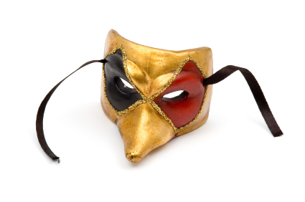
Characters

Slide 19
Shakespeare’s Othello
Major Characters
Othello: A general in the Venetian military
Desdemona: Othello's wife and daughter of Brabantio
Iago: Othello's ensign (3rd in command) - Emilia's husband
Cassio: Othello's lieutenant (2nd in command)
Emilia: Iago's wife and Desdemona's maidservant
Bianca: Cassio's lover
Brabantio: a Venetian senator and Desdemona's father
Roderigo: a Venetian man in love with Desdemona

Slide 20
Shakespeare’s Othello
Minor Characters
Duke of Venice
Gratiano: Brabantio's brother
Lodovico: Brabantio's kinsman and Desdemona's cousin
Montano: Governor of Cyprus
Clown: a servant
Officers, Gentlemen, Messenger, Attendants, Musicians, etc.

Slide 21


Slide 23
William Shakespeare’s Othello
Popularity of Othello
One reason for the overwhelming popularity of the play throughout the ages is that it focuses on two people who defied society in order to follow their own hearts.
More has been written about
Most _________ character in literature?

Slide 24
William Shakespeare’s Othello
Passages to Examine
Act #. Scene # - CHARACTER: line
Act #. Scene # - CHARACTER: line
Act #. Scene # - CHARACTER: line
Act #. Scene # - CHARACTER: line
Act #. Scene # - CHARACTER: line

