Slide 1
A Raisin in the Sun
by Lorraine Hansberry

Slide 2
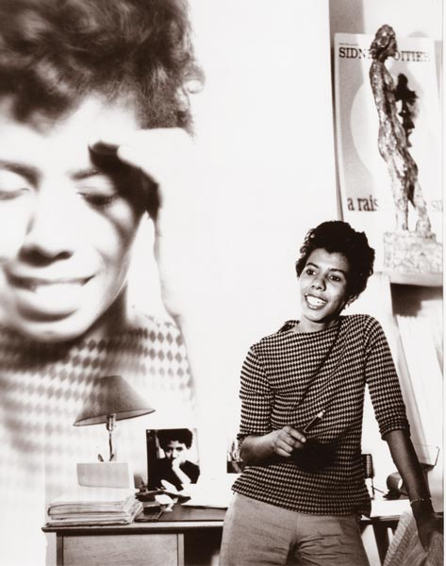
A Raisin in the Sun
by Lorraine Hansberry

Slide 3
Lorraine Hansberry
Born in Chicago, IL on May 19, 1930
Playwright and civil rights activist
First Black woman to have a play produced on Broadway
Youngest American to win a New York Critics’ Circle award
Died at age 34 of pancreatic cancer on January 12, 1965

Slide 4
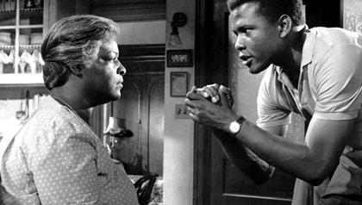
The Play

Slide 5
A Raisin in the Sun
Opened on Broadway on March 11, 1959
Cast included Sidney Poitier, Claudia McNeil and Ruby Dee
The New York Drama Critics named it the Best American Play of 1959
Made into a film starring most of the Broadway cast in 1961

Slide 6

A Raisin in the Sun
TV Movie with Sean Combs and Phylicia Rashad – 2008
Denzel Washington,
Diahann Carroll and
Anika Noni Rose set to
star in Broadway revival
– March, 2014

Slide 7
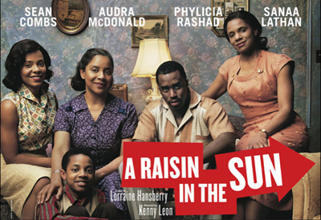
Hansberry’s play, illustrating Black America’s struggle to gain equal access to opportunity –

Slide 8
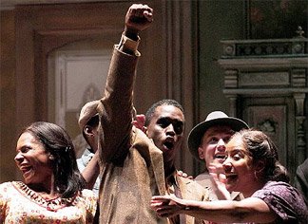
foretold the revolution in Black consciousness . . .

Slide 9
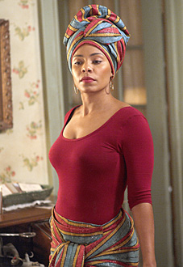
and the revolution in women’s consciousness.

Slide 10
HISTORICAL CONTEXT

Slide 11
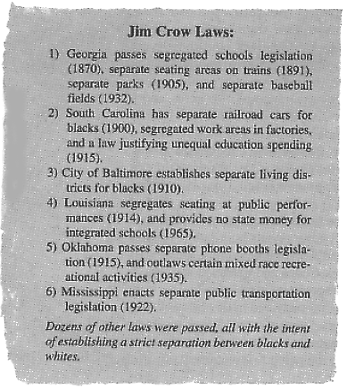
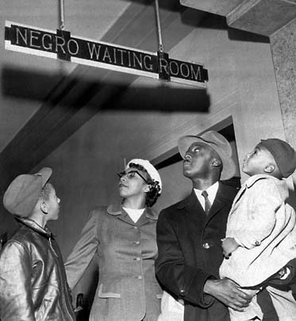
Jim Crow Laws

Slide 12
The Great Migration
Beginning around 1910
Movement of 6 million African Americans out of the rural Southern U.S. to the urban Northeast, Midwest and West

Slide 13
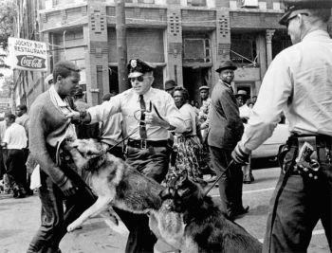
Racism and Segregation

Slide 14

Sexism and Gender Discrimination

Slide 16
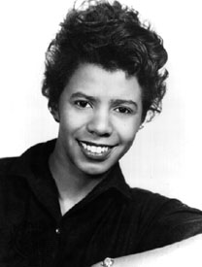
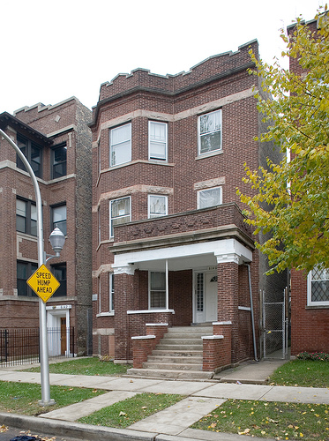
Connection with Hansberry’s Life
Hansberry’s father was a wealthy, real estate broker in segregated Chicago
In 1937, her father purchased a home in the Washington Park Subdivision
  Washington Park had a restrictive covenant that said no Black person could live in, or own a home in, the subdivision
Washington Park fought Hansberry and they went to court in 1937

Slide 17
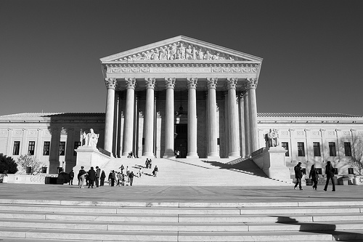
The case of Hansberry et al vs. Lee et al goes all the way to the Supreme Court of the United States on October 25, 1940
U.S. Supreme Court
rules against
restrictive covenants

Slide 18
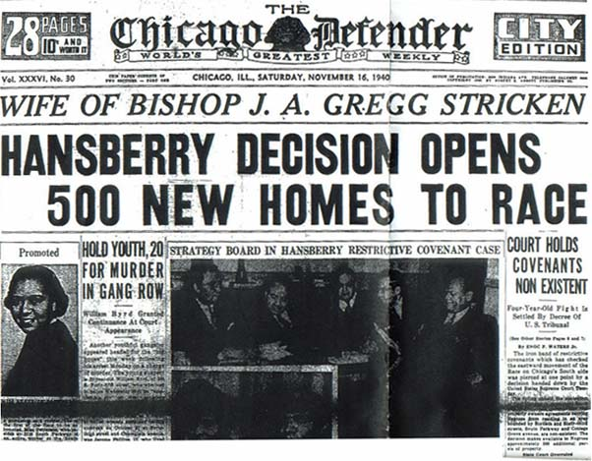
“Hansberry Decision Opens
500 New Homes to Race”
The Chicago Defender
Saturday, November 16, 1940

Slide 19
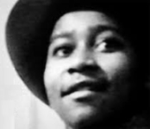
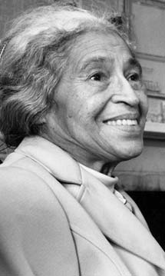
A Raisin in the Sun was published in 1959, four years after the murder of Emmett Till and Rosa Parks’ arrest for refusing to give up her seat to a White person on a bus –
sparking the Civil Rights Movement.

Slide 20
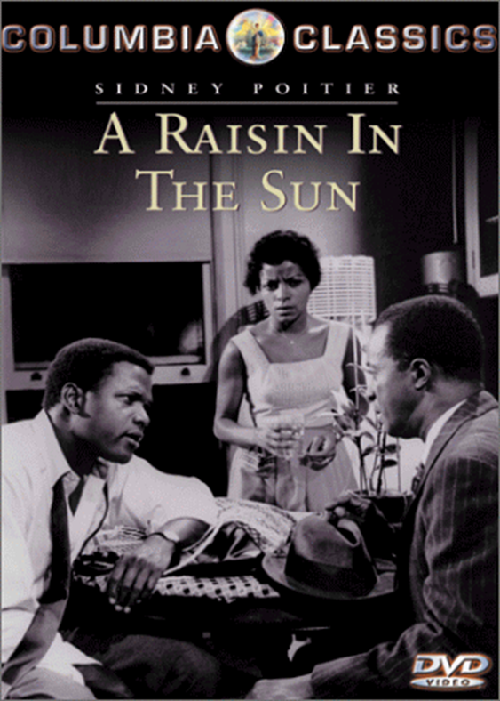
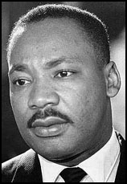

Slide 21
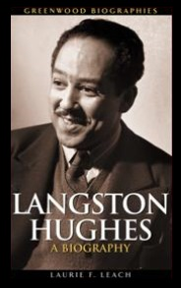
Harlem
by Langston Hughes
The title of the play is taken from Hughes’ poem about “a dream deferred.”

Slide 22
Harlem
by Langston Hughes
What happens to a dream deferred?
Does it dry up
like a raisin in the sun?
Or fester like a sore –
And then run?
Does it stink like rotten meat?
Or crust and sugar over –
like a syrupy sweet?
Maybe it just sags
like a heavy load.
Or does it explode?

Slide 23

Hansberry’s title may
also metaphorically imply
an upbringing (a raisin’)
in a sunny place that
permits growth

Slide 24
Themes
Value systems within families
Concepts of African American beauty
vs. European beauty
Class and generational conflicts
Male pride
Rising feminism
Assimilation –
“melting pot” vs. multiculturalism

Slide 25
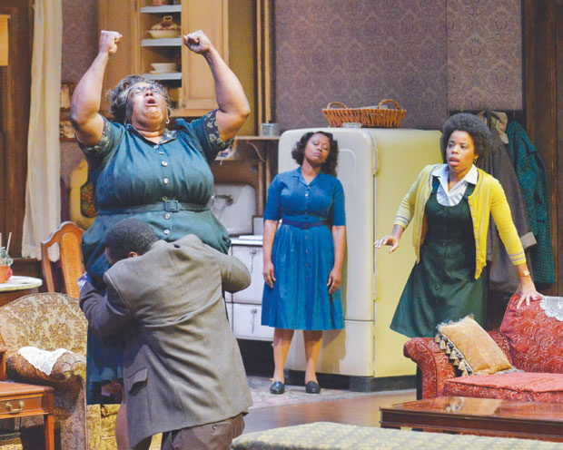

Slide 26
Setting
South Side, Chicago
some time between World War II and the present

Slide 27
Main Characters
Ruth Younger
Travis Younger
Walter Lee Younger (brother)
Beneatha Younger (sister)
Lena Younger (Mama)
George Murchison
Joseph Asagai
Karl Lindner

Slide 28
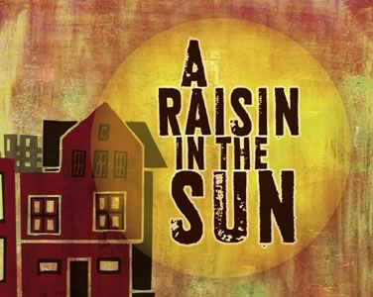

Slide 30
Other Works by Lorraine Hansberry:
What Use Are Flowers?
The Drinking Gourd
The Movement: Documentary of a Struggle for Equality
The Sign in Sidney Brustein’s Window
To Be Young, Gifted and Black
Les Blancs

