Slide 2
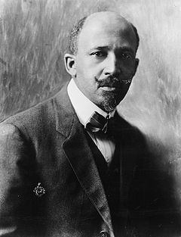
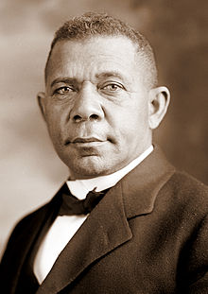
Booker T. Washington
W. E. B. Dubois
and
opposing viewpoints on social justice

Slide 3
opposing viewpoints on social justice

Slide 4
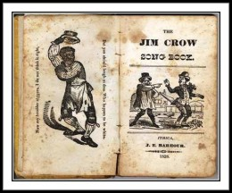
Jim Crow
Throughout the 1800s, white entertainers wore dark clown make-up and performed as Black characters in "blackface minstrel shows." One of the most popular characters was called Jim Crow.
Minstrel Show

Slide 5
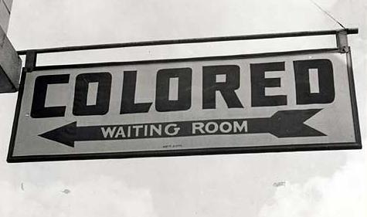
Jim Crow
After the Civil War, most southern states passed laws that denied African Americans their basic human rights.
The minstrel character's name "Jim Crow" became a metaphor -- shorthand for the laws that demeaned African Americans and segregated housing, health care, schooling, transportation and business.
Laws

Slide 6
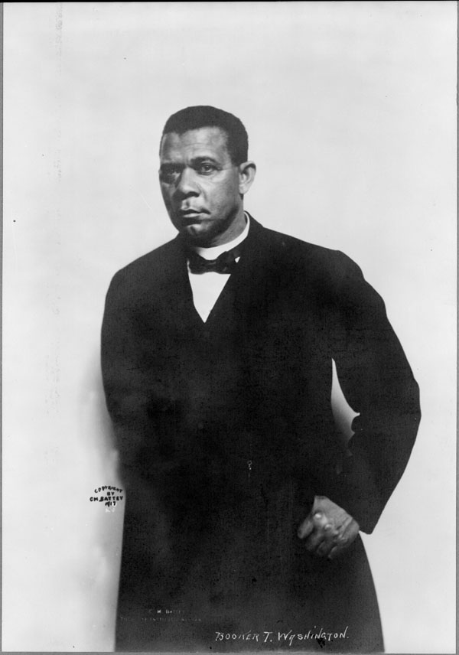
Booker T. Washington
Outlined his views on race relations in a famous 1895 speech known as the – “Atlanta Compromise”
Felt that Black people should work to gain economic security before equal rights
Believed Black people would “earn” equality
(1856 - 1915)

Slide 7
Booker T. Washington
Founded Tuskegee Institute in Alabama to develop job training programs
Asked Whites to give job opportunities to Black people
Was popular with White politicians in the North and South
Associated with leaders of the Urban League which emphasized jobs
(1856 - 1915)

Slide 8
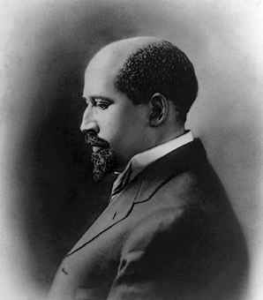
W. E. B. Dubois
William Edward Burghardt
Views expressed in his towering work:
The Souls of Black Folks – 1903
Strongly opposed Booker T. Washington’s tolerance of segregation
Demanded immediate equality for Blacks
(1868 - 1963)

Slide 9
W. E. B. Dubois
Founding member of the NAACP
Believed it was wrong to expect citizens to “earn their rights”
Felt Black students should obtain a classical higher education
(1868 - 1963)

Slide 10
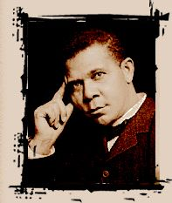
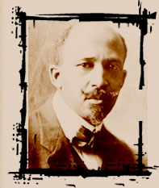
Booker T. W. E. B.
Washington & Dubois
Booker T. Washington held a philosophy of self-help, racial solidarity and assimilation
W. E. B. Du Bois advocated political action and a civil rights agenda

Slide 11
Booker T. W. E. B.
Washington & Dubois
Booker T. Washington held a philosophy of self-help, racial solidarity and assimilation
W. E. B. Du Bois advocated political action and a civil rights agenda

Slide 12
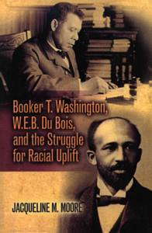
Booker T. W. E. B.
Washington & Dubois

